Slide 1

EE932 - Intro to Reinforcement Learning
eMasters – Q4-2023-24 – Mar-Apr-2024
IIT Kanpur
Venkateswar Reddy Melachervu
CTO
14th Apr 2024
Brillium Technologies
#501, C Block, Salarpuria Serenity, 5th Main, Sector 7, HSR Layout, Bengaluru 560102, Karnataka, India
Website: www.brillium.in | Email: connect@brillium.in

Slide 2
EE902 Course Objectives
Reinforcement learning (RL) is a type of machine learning paradigm where an agent learns how to behave in an environment by performing actions and receiving feedback in the form of rewards or penalties.
RL algorithms have proven effective in solving intricate problems across diverse domains such as robotics, gaming, finance, and communication networks.
This course aims to provide students with a solid understanding of the various RL algorithms, enabling them to apply this knowledge to their specific research areas.
The topics covered are:
  Multi-armed Bandits
  Finite MDP and Dynamic Programming
  Monte-Carlo and Temporal Difference-based Tabular Methods
  Function Approximation-based Methods
  Applications

Slide 3
Multi-armed Bandits
A probability theory or machine learning problem in which:
  A decision maker iteratively selects one of multiple fixed choices (i.e. arms or actions) when the properties of each choice are only partially known at the time of allocation, and may become better understood as time passes
Instances of the multi-armed bandit problem include the task of iteratively allocating a fixed, limited set of resources between competing (alternative) choices in a way that minimizes the regret
Alternative setups for the multi-armed bandit problem include the "best arm identification" problem where the goal is instead to identify the best choice by the end of a finite number of rounds
The multi-armed bandit problem is a classic reinforcement learning problem that exemplifies the exploration–exploitation tradeoff dilemma.
The multi-armed bandit problem also falls into the broad category of stochastic scheduling.
In the problem, each machine provides a random reward from a probability distribution specific to that machine, that is not known a-priori.
The objective of the gambler is to maximize the sum of rewards earned through a sequence of lever pulls
A theorem, the Gittins index, first published by John C. Gittins, gives an optimal policy for maximizing the expected discounted reward

Slide 4
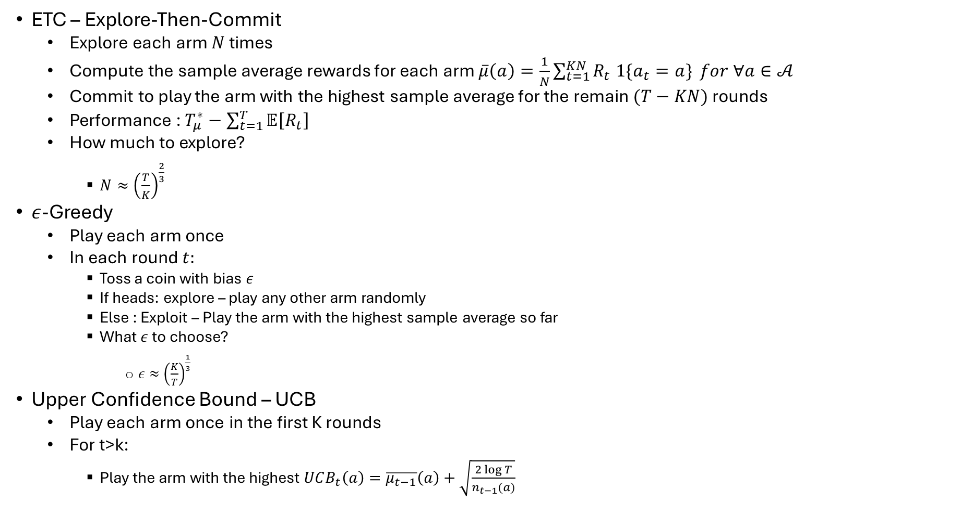
Explore Vs Exploitation Dilemma
ETC – Explore-Then-Commit
  Explore each arm $N$ times
  Compute the sample average rewards for each arm $\overline{μ}\left(a\right)=\frac{1}{N}\sum_{t=1}^{KN}{R_{t} 1\{a_{t}=a\}} for ∀a∈𝒜$
  Commit to play the arm with the highest sample average for the remain $(T−KN)$ rounds
  Performance : $T_{μ}^{∗}−\sum_{t=1}^{T}{𝔼\left[R_{t}\right]}$
  How much to explore?
    $N≈{\left(\frac{T}{K}\right)}^{\frac{2}{3}}$
$ε$-Greedy
  Play each arm once
  In each round $t:$
    Toss a coin with bias $ε$
    If heads: explore – play any other arm randomly
    Else : Exploit – Play the arm with the highest sample average so far
    What $ε$ to choose?
      $ε≈{\left(\frac{K}{T}\right)}^{\frac{1}{3}}$
Upper Confidence Bound – UCB
  Play each arm once in the first K rounds
  For t>k:
    Play the arm with the highest $UCB_{t}\left(a\right)=\overline{μ_{t−1}}\left(a\right)+\sqrt{\frac{2\log{T}}{n_{t−1}(a)}}$

Slide 5
Contextual Bandits – Multiple States
News Article Recommendation System
  Articles – arms
  Like/Dislike – Reward
  User – State
Bandits + Supervised Learning

Slide 6
Thank you
Brillium Technologies
#501, C Block, Salarpuria Serenity, 5th Main, Sector 7, HSR Layout, Bengaluru 560102, Karnataka, India
Website: www.brillium.in | Email: connect@brillium.in

